Slide 1
HealthY Snack bar
Capstone Data Science project

Slide 2
Business Problem
To launch Healthy Snack Center in USA. Preferred cities are New York City and Los Angeles.
Comparison between cities as to which would be the best choice for 1st launch
Healthy Snack Center can also have fitness equipment/accessories as supplementary sale.

Slide 3
Solution
Best place to launch Healthy Snack Bar is near Gyms/Fitness Centres of the city.
Using Folium, map would be plotted for both cities to see the diversity in type of fitness centre and more the health centres together in a cluster, more chances of selecting the place for opening Healthy Snack bar.

Slide 4
Data Used
Foursquare places API to get the health centres and plot them using Folium maps
Filtering the data on basis of category of establishment (gym/fitness centre/yoga) and plotting them using Matplotlib library

Slide 5
Methodology
Searching the health centres on basis of Latitude and Longitude and plotting them on Map
The proximity of 4 or more centres is sufficient to consider a prospective area/neighbourhood.
Categorising the type of establishment to reckon focus areas for store/snack bar.

Slide 6
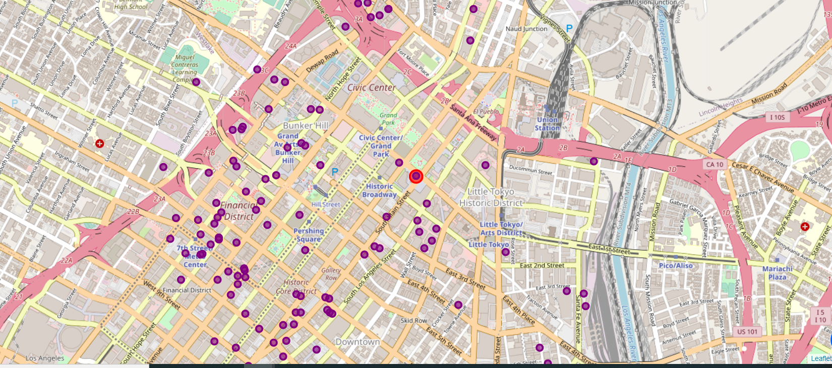
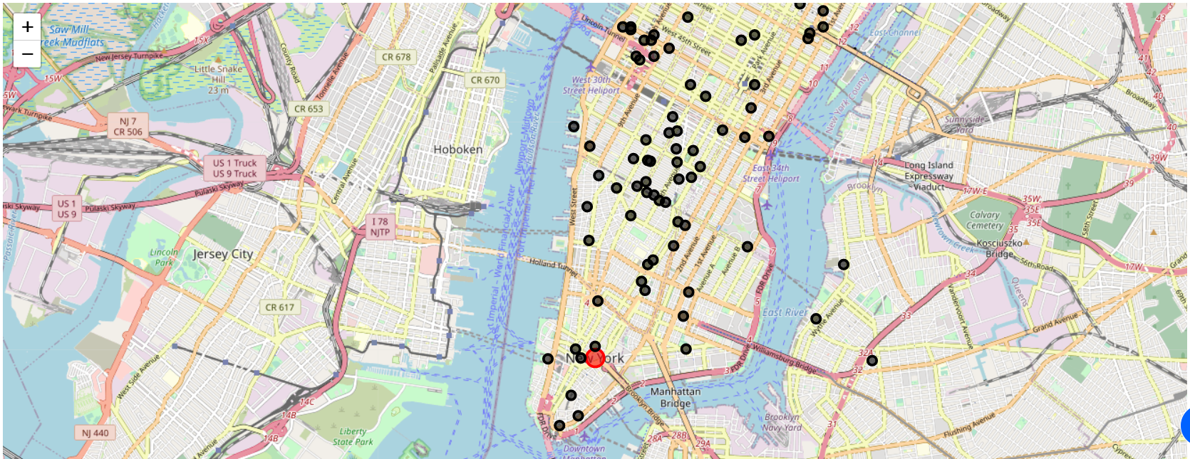
Results
Los Angeles
New York City

Slide 7
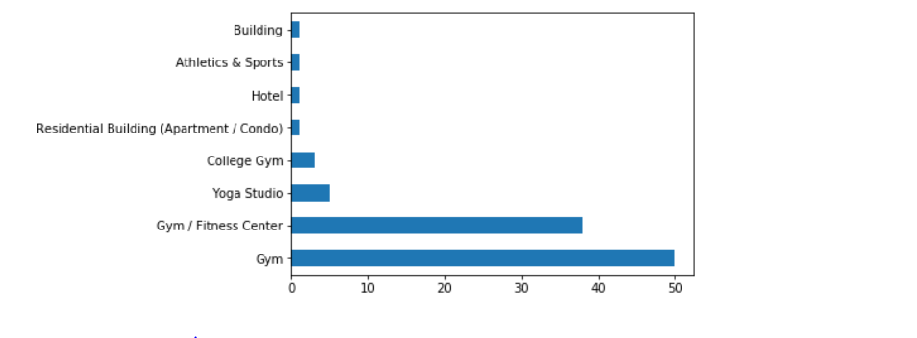
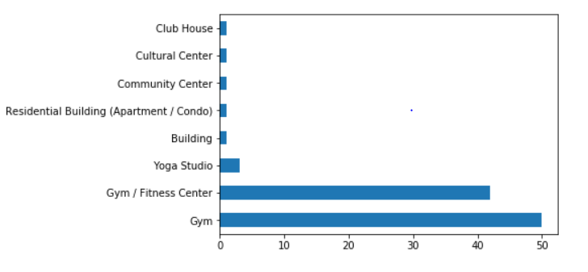
Results
Los Angeles
New York City

Slide 8
Conclusion
Both the cities have almost equal spread of health centres.
LA has approx. 96% are established standalone health centers and 4% places are either in building or residential complex and for NYC, number is almost similar with 95% established centers and 5% building or shared complexes.
LA has around 6 prospective centres: Financial District, Historic Core District, Bunker Hill, Hope Place, Orsini, South Main Street.
NYC has around 5 prospective centres: Bleecker Street, Union Square, Lincoln Tunnel, 86th Street, 70th Street
LA being lesser expensive and more accessible is a better choice to open first center with areas mentioned as above.
Source: (https://www.bestplaces.net/cost-of-living/los-angeles-ca/new-york-ny/100000)

